Slide 1
Research Progress Presentation 2
Lim Liang Sun (B4)
12 December 2024

Slide 2
Outline
Recap
Progress
New simulation video
Key differences
Target Identification
Self-to-neighbour communication
Grouping (splitting of tasks)

Slide 3
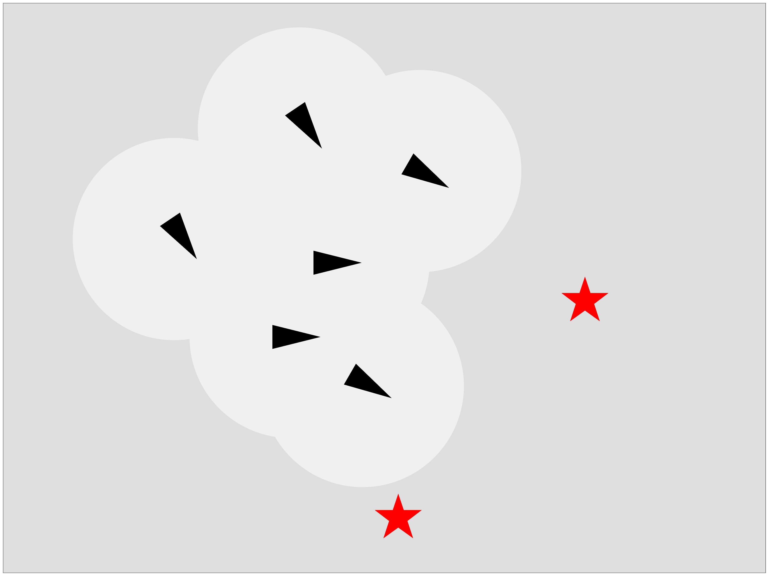

Research topic (Recap)
Coverage and task splitting of multi-agent flocks with distributed control
Goal
cover all point of interests (POIs) in an unmapped region

Slide 4
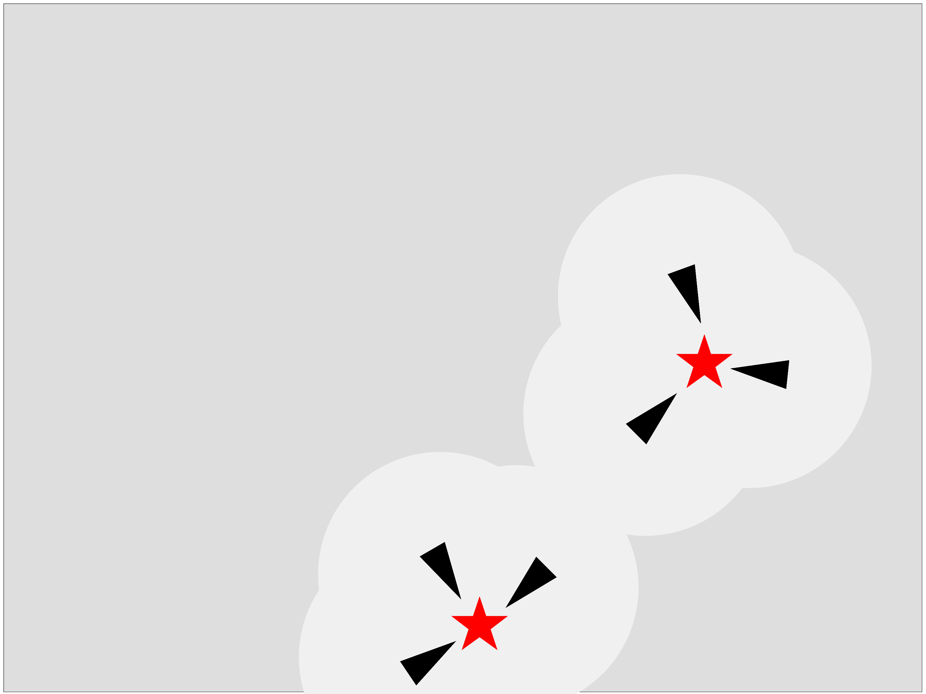
Problem Setting (Recap)
Bounded unmapped 2D area
POI can appear any time
Need 3 boids on each POI for task completion
Continue swarming

Slide 5
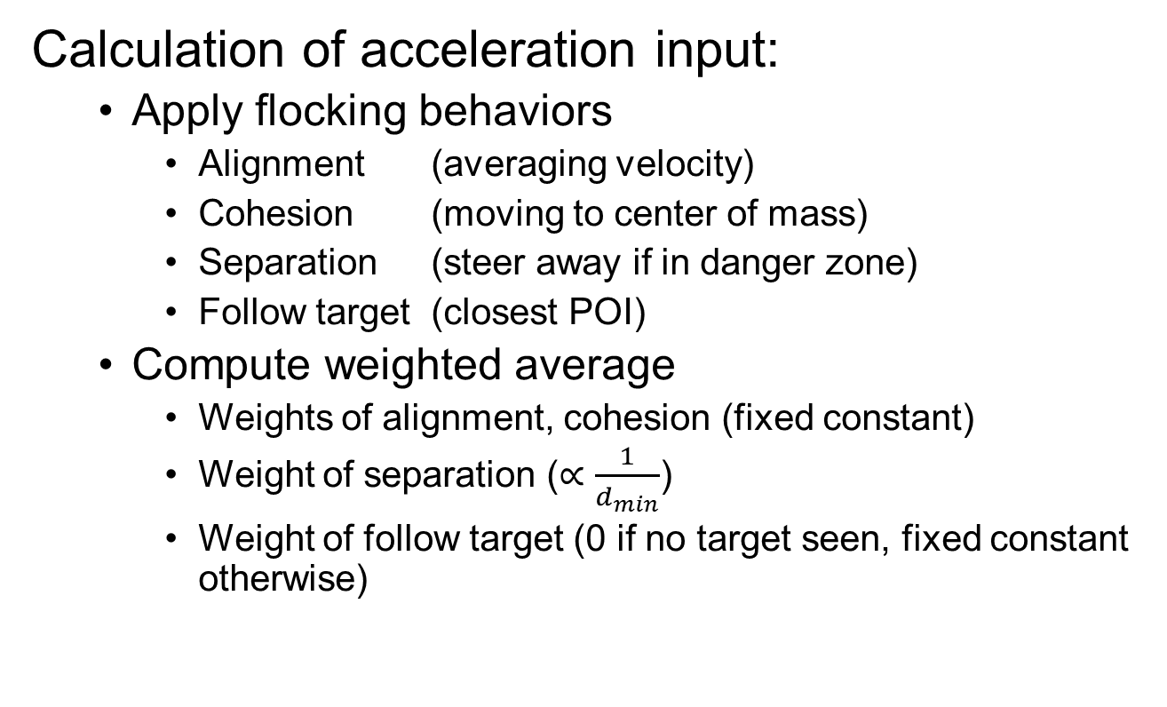
Simulation Recap (1)
Calculation of acceleration input:
Apply flocking behaviors
Alignment (averaging velocity)
Cohesion (moving to center of mass)
Separation (steer away if in danger zone)
Follow target (closest POI)
Compute weighted average
Weights of alignment, cohesion (fixed constant)
Weight of separation ($∝\frac{1}{d_{min}}$)
Weight of follow target (0 if no target seen, fixed constant otherwise)

Slide 6
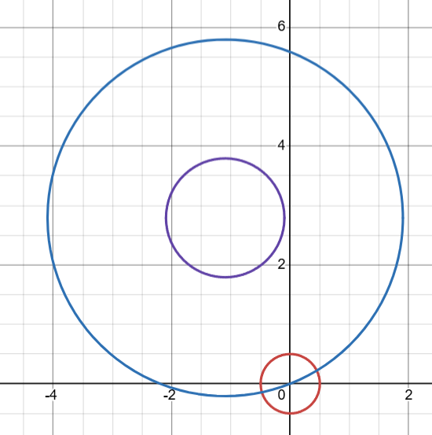
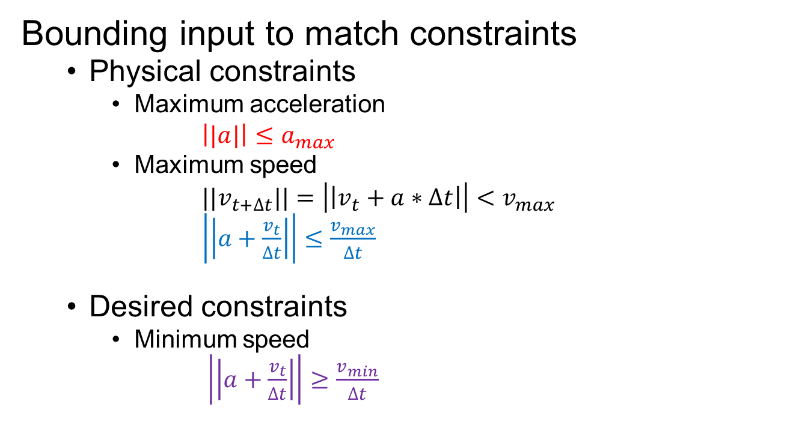
Simulation Recap (2)
Bounding input to match constraints
Physical constraints
Maximum acceleration
$\left||a|\right|≤a_{max}$
Maximum speed
${||v}_{t+∆t}||=\left|\left|v_{t}+a∗∆t\right|\right|<v_{max}$
$\left|\left|a+\frac{v_{t}}{∆t}\right|\right|≤\frac{v_{max}}{∆t}$
Desired constraints
Minimum speed
$\left|\left|a+\frac{v_{t}}{∆t}\right|\right|≥\frac{v_{min}}{∆t}$

Slide 7
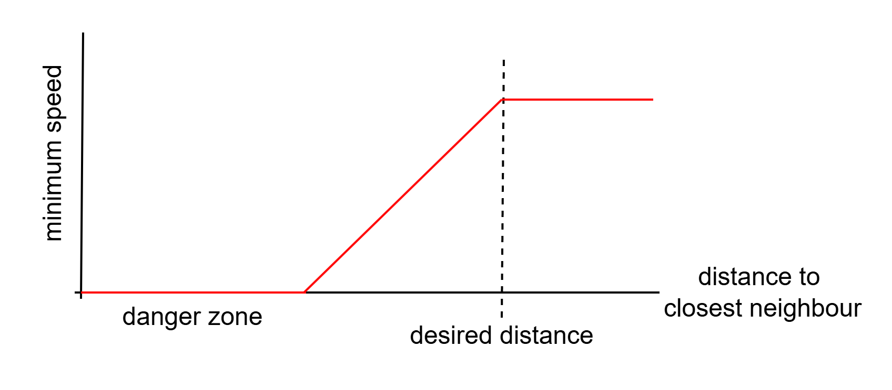
Simulation Recap (3)
Design of minimum velocity constraint
Promote exploration
While still prioritizing no collisions

Slide 8
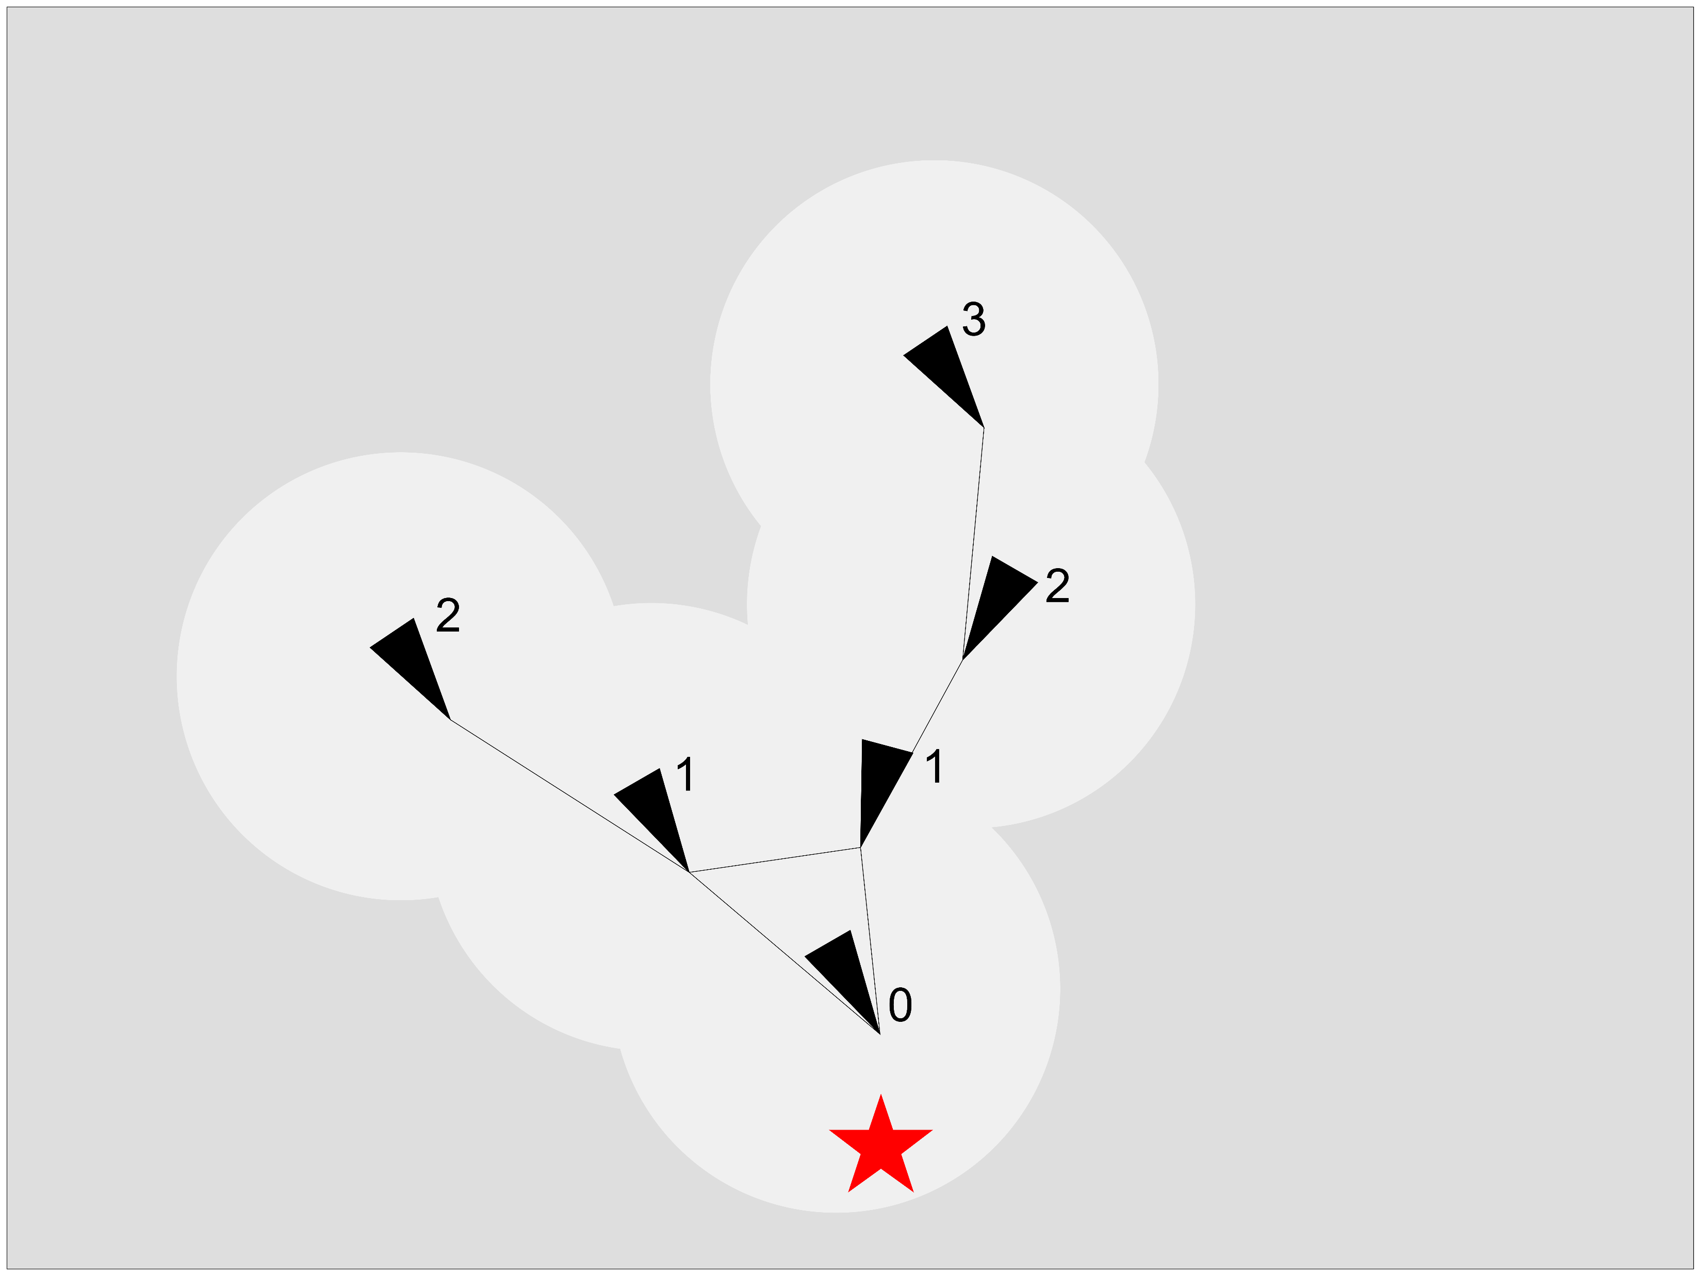
Simulation Recap (4)
Ranking System
higher weight (2x) to lower rank neighbors
normal weight (1x) to same rank neighbors
lower weight (0.5x) to higher rank neighbors

Slide 9
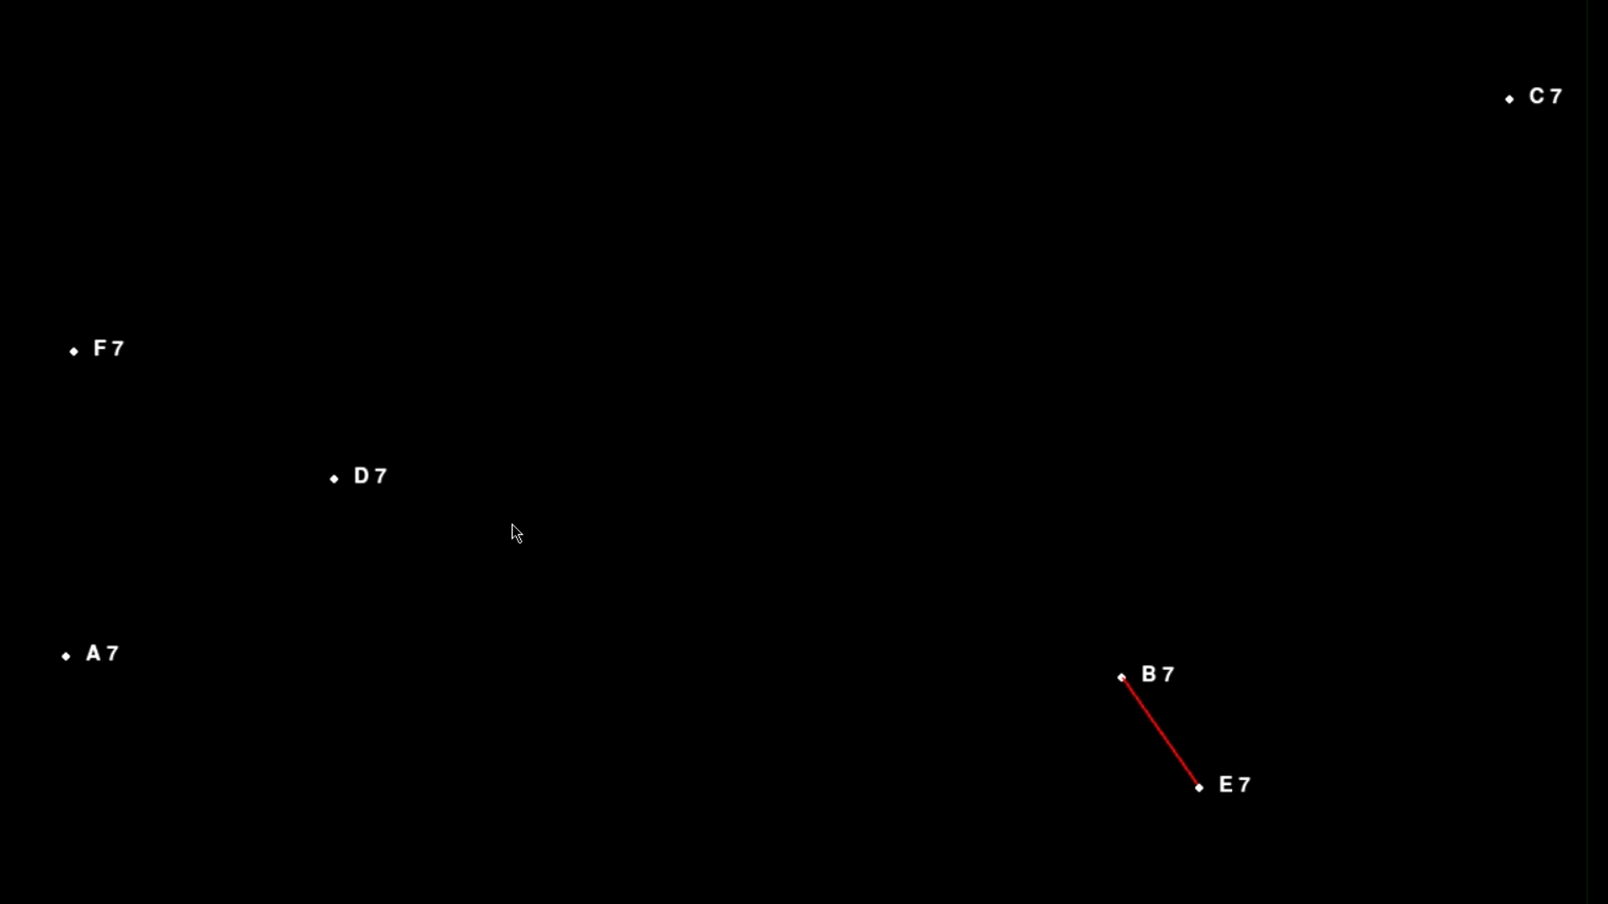
Previous Simulation Video

Slide 10
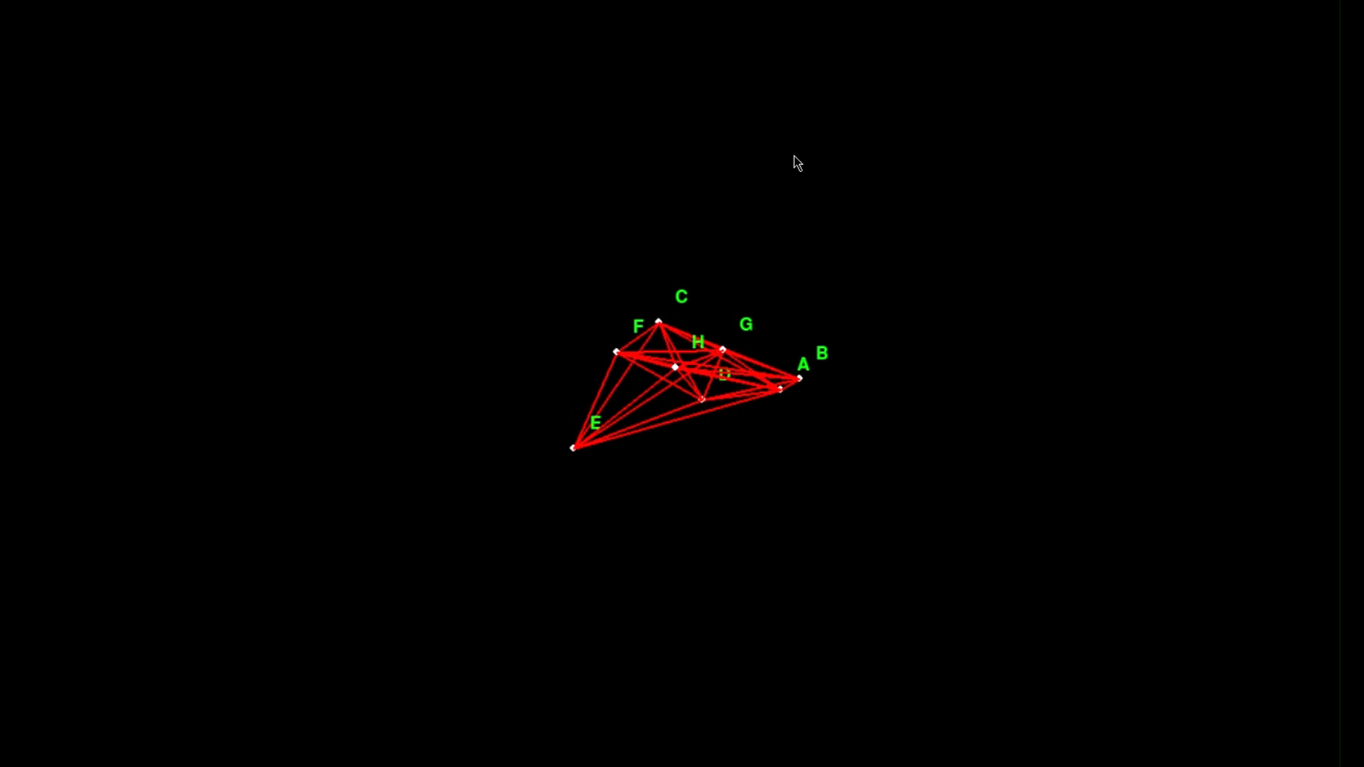
New Simulation Video

Slide 11
Key Difference
Previous Sim
Oscillatory
Stays around an area
Can only handle 1 target
Current Sim
Less oscillatory
Move together as a unit
Ability to diff. target
Timer for each target
New ranking system
Self-to-neighbour communication
Task Splitting (Grouping)

Slide 12
Target Identification
Assume target can be distinguished by its global position
Can be calculated using relative coordinates

Slide 13
Self-to-neighbour Comm.
Neighbour’s information accessed by self:
neighbour’s targets = [ ] of length n
List of targets known in network
neighbour’s ranks = [ ] of length n
List of rank corresponding to each target in network
neighbour’s removed_targets = [ ]
List of newly removed targets due to task completion
neighbour’s continue_targets = [ [ , ] ]
List of [target, countdown] that still exists in network
Renew timer of target still exists

Slide 14
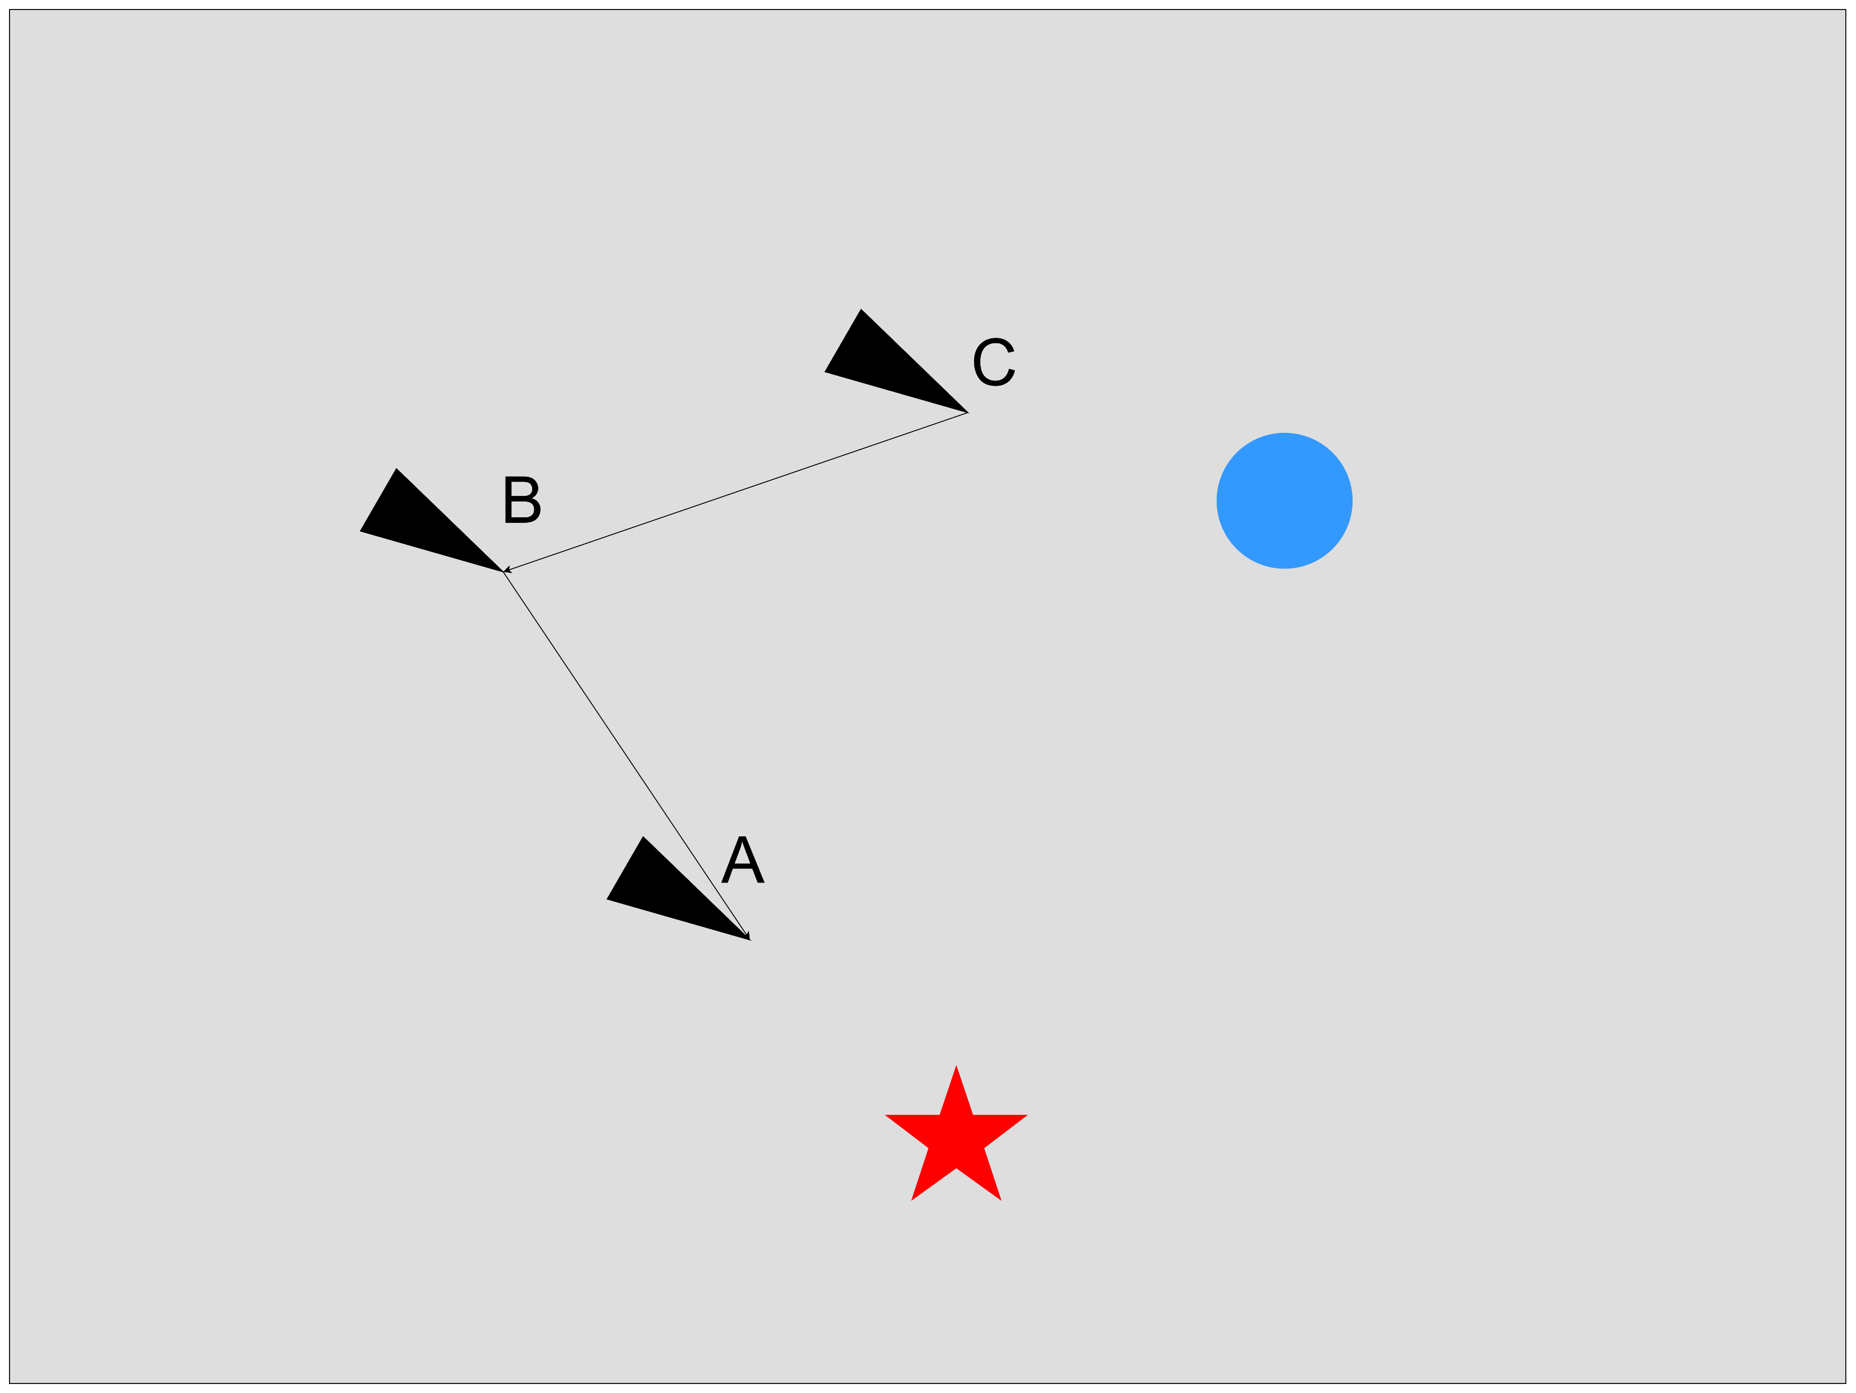

(Ex)
Boid | Attribute | T=1 | T=2 | T=3 |  | T=4 | T=5 | T=6 | T=7 | T=8
A | Targets
 | Ranks | [0] | [0] | [0, 2] |  | [0, 2] | [0, 2] | [0, 2] | [0] | [0]
 | Timer | [3] | [3] | [3, 3] |  | [3, 3] | [3, 2] | [3, 1] | [3] | [3]
 | Continue targets
 | Remove targets
B | Targets
 | Ranks |  | [1, 1] | [1, 1] |  | [1, 1] | [1, 1] | [1, 1] | [1, 1] | [1]
 | Timer |  | [3, 3] | [3, 3] |  | [3, 3] | [3, 3] | [3, 2] | [3, 1] | [3]
 | Continue targets
 | Remove targets
C | Targets
 | Ranks | [0] | [0] | [0, 2] |  | [0, 2] | [0, 2] | [0] | [0] | [0]
 | Timer | [3] | [3] | [3, 3] |  | [3, 2] | [3, 1] | [3] | [3] | [3]
 | Continue targets
 | Remove targets
3
3
3
1
3
1
3
3
3
3
2
2
2
2
2
0
2
0
2
2
2
3
3
3
1
3
3
3
3
3

Slide 15
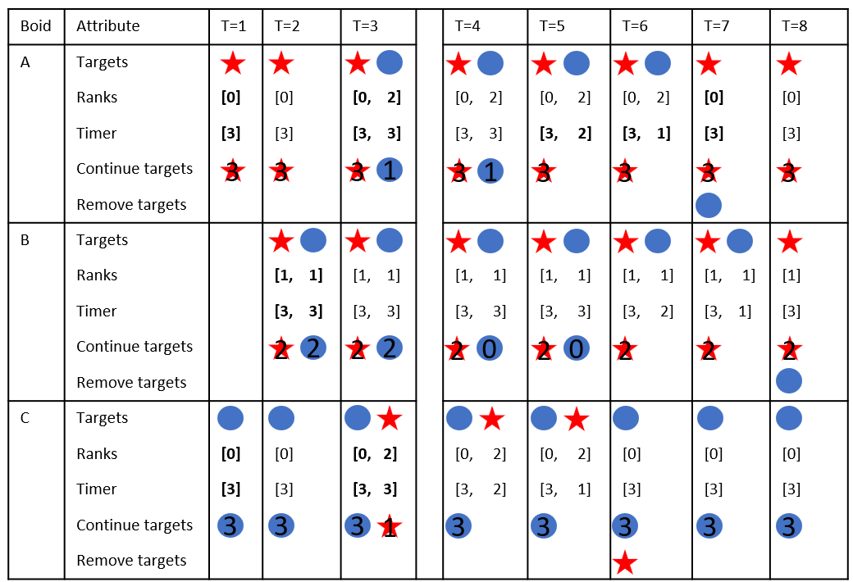
A-B-C
A-B C

Slide 16
Task Splitting
Determined by which target has the lowest rank

Slide 17
Future Work
Consider edge cases
Use better task splitting algorithm
Test on 3 targets
Add obstacles to avoid

